Slide 1
International study centre
An Introduction to object-orientation and the java programming language
Name : John Alamina
Email : john.alamina@hud.ac.uk

Slide 2
Outline
Object Oriented programming
Abstraction
Encapsulation
Inheritance
Polymorphism
OOP keywords
Class diagrams
Class example
Class members
Object Instantiation
Constructors
this pointer
String class

Slide 3
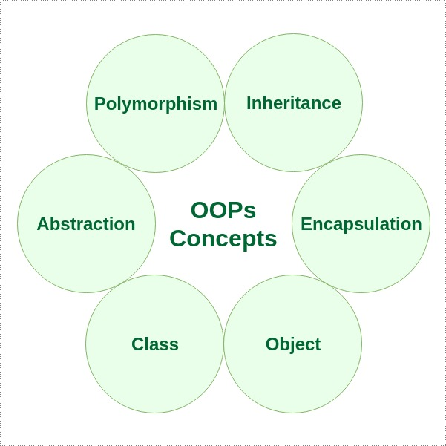
Object-Orientation.
Object-orientation is a software design concept which is used to build systems from a collection of reusable components called objects.
Objects contain data in the form of fields and functionality in the form of procedures. These are grouped together to represent an entity.
Object-oriented design involves defining the objects and their interactions to solve a problem.

Slide 4
Features of Object-oriented Designs.
Abstraction – The identification/description of the essential characteristics of an item.
Encapsulation – The grouping of related concepts into one item, such as a class or component
Inheritance – Inheritance enables new classes to receive the properties and methods of an existing class.
Polymorphism – The ability of different object to respond to the same message in different ways.

Slide 5
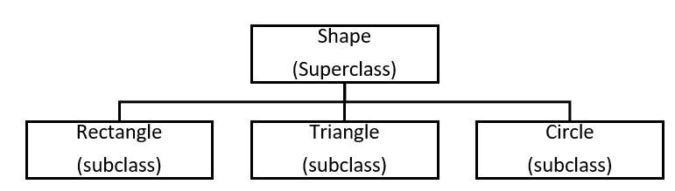
Terms Used in Object-oriented Design.
Object – A person, place, thing, event, concept, screen or report.
Class – A template from which objects are created, it is a software abstraction of a group of objects with common properties (Attributes), behaviour (operations).
Subclass – If class “B” inherits from class “A”, class “B” is a subclass of “A” and “A” is a superclass of “B”.
Abstract class – A class that does not have objects created from it.
Association – Relationship between objects.

Slide 6
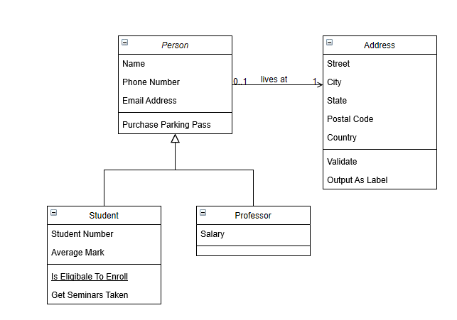
Working with class diagrams
Go to www.draw.io >> choose “save diagrams to device” >> click “create new diagram” >> select “Class Diagram”.
The following example should be shown on your screen:

Slide 7
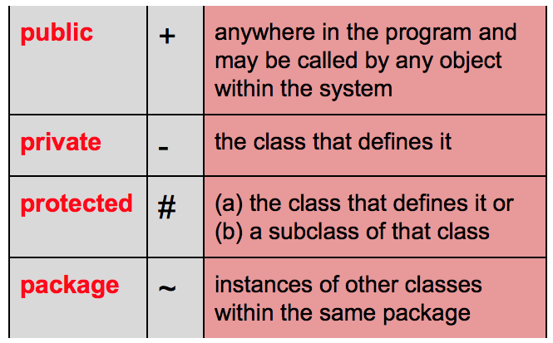
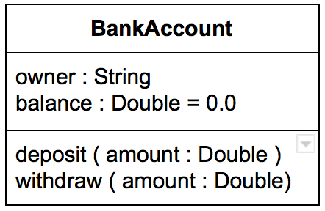
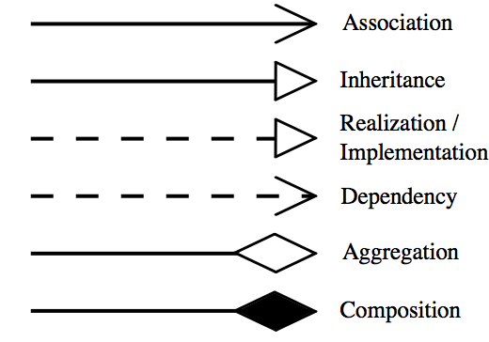
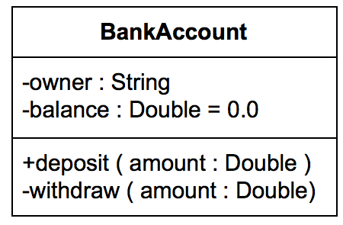
Representations in UML.
Visibility of class members
Class Representation
Class name
Class attributes
Class methods
Relationships

Slide 8
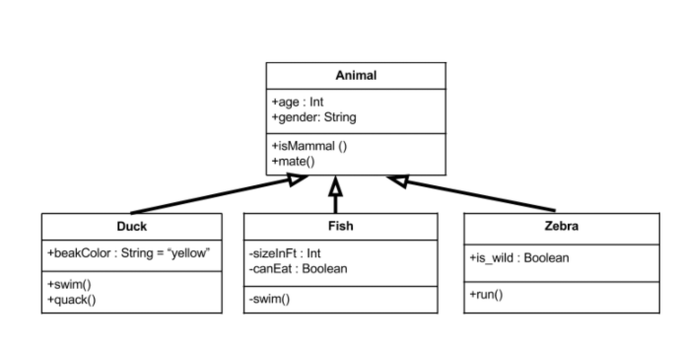
Class Diagram – Example.
Animal is the super class. Duck, Fish, and Zebra are subclasses and they inherit all the members from the superclass. The subclasses also have their own attributes and methods.

Slide 9
Any Questions?

